Slide 1
Social Security: With You Through Life’s Journey…
Produced at U.S. taxpayer expense
Notes:
(2019 Universal PowerPoint)
Notes to speaker:
You may want to add the name of the organization or event (seminar, conference, workshop, etc.) and the date of the event to this slide by clicking Insert, then clicking Text Box, and typing in the details.
DO NOT remove the taxpayer expense disclaimer from this slide, as it is now required by law.
Be sure to thank the person who invited you to speak, thank the organization for making SSA a part of today’s event, and make a few introductory comments (such as how long you have worked at SSA, your job title, and why you feel Social Security is relevant to this event/organization).
BEGINNING OF SPEAKER’S FORMAL SCRIPT:
For more than 80 years, Social Security has helped secure today and tomorrow by providing benefits and financial protection for millions of people throughout their life’s journey.
Social Security touches the lives of every American, both directly and indirectly. As you consider the information that you are about to receive, I encourage you to think about all the ways Social Security has been linked to your life – and the lives of your loved ones.

Slide 2
We’re With You If
The Unexpected Happens
Notes:
Disability could happen at any moment in our lives. Social Security disability benefits provide financial support to people when they need it most.
For people who can no longer work due to a disability, our disability program is there to replace some of their lost income.
Disability benefits provide modest coverage for severely disabled workers and their dependents, including wounded warriors.

Slide 3
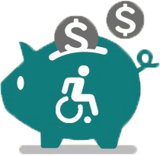
Disability Benefit Statistics
As of December 2018, Social Security paid an average monthly disability benefit of $1,096.99 That’s barely enough to keep a beneficiary above the poverty guidelines ($12,490 annually).
According to the U.S. Census Bureau, 56.7 million people living in the United States - 19% of the population - live with a disability.
38.3 million people - 13% of the population - live with a severe disability.
Notes:
Stats:
Social Security disability payments are modest. As of December 2018, Social Security paid an average monthly disability benefit of $1,096.99. That is barely enough to keep a beneficiary above the poverty guidelines ($12,490 annually, as of January 2019).
- According to the U.S. Census Bureau, 56.7 million people living in the United States - 19% of the population - live with a disability (as of 2010 – most current stats.)
- 38.3 million people - 13% of the population - live with a severe disability.
https://www.ssa.gov/policy/docs/quickfacts/stat_snapshot/index.html?qs (Table 2)
https://aspe.hhs.gov/poverty-guidelines
https://www2.census.gov/library/publications/2012/demo/p70-131.pdf (Table 1)
Source: ^Statistics
Slide updated 1/15/2019

Slide 4
SSDI vs. SSI
Social Security Disability Insurance | Supplemental Security Income
Payments come from the Social Security trust funds and are based on a person’s earnings. | Payments come from the general treasury fund, NOT the Social Security trust funds. SSI payments are not based on a person’s earnings.
An insurance that workers earn by paying Social Security taxes on their wages. | A needs-based public assistance program that does not require a person to have work history.
Pays benefits to disabled individuals who are unable to work, regardless of their income and resources. | Pays disabled individuals who are unable to work AND have limited income and resources.
Benefits for workers and for adults disabled since childhood. Must meet insured status requirements. | Benefits for children and adults in financial need. Must have limited income and limited resources.
Notes:
When you file an application for disability benefits with Social Security, we always check on your eligibility for both of our programs.
The same medical requirements apply to both programs, but the non-medical requirements differ.
Staff at your local Social Security field office review your non-medical eligibility. If you meet the non-medical requirements for SSDI, SSI, or both programs, we send your claim – or claims – to a medical examiner who works for the state of ___(your state).
Specifically, the medical examiners work for a state agency called the Disability Determination Service, or DDS. Once the medical examiner makes a medical decision on your application, you receive notification by mail, and your local Social Security field office receives notification electronically. If your claim is approved, you start receiving monthly disability benefits. If denied, you have 60 days to file an appeal.
For SSDI, you must have recent work history in order to receive benefits. Adults must have worked and earned Social Security credits in 5 out of the 10 years prior to the onset of the disability.
For younger workers, however, less work is required. For example:
Before age 24:
1 ½ years of work in a three-year period before becoming disabled
Age 24-31:
work during half the time between age 21 and the time the disability began
Age 31 or older:
work during five out of the 10 years before the disability began
However, since you do not need to work and gain insured status for SSI, babies and older people who have never worked can receive SSI benefits. They just need to be blind, disabled, or age 65 or older and have limited income and resources.
Social Security has a specific set of rules that apply to disability beneficiaries. If you receive Social Security disability benefits or Supplemental Security Income payments, you must report all earnings to Social Security.

Slide 5
Supplemental Security Income (SSI)
What is it?
SSI is a federal program that provides monthly payments to people who have limited income and few resources.
Who is it for?
People who are 65 or older, as well as for those of any age, including children, who are blind or who have disabilities.
Notes:
SSI stands for Supplemental Security Income. Social Security administers the SSI program, which pays monthly benefits to adults with limited income and resources who are disabled, blind, or age 65 or older. Blind or disabled children may also get SSI.
People who have worked long enough, recently enough, may be able to receive Social Security benefits – such as disability or retirement – and SSI benefits at the same time, if the amount of Social Security benefits in combination with the person’s other income falls below the SSI income limits.

Slide 6
SSI Federal Payment Rates
Effective January 2019:
Individual $771/month
Couple $1,157/month

Slide 7
SSI Benefits for Adults
Resource Limits
$2,000 for individual
$3,000 for couple
Count the value of
Bank accounts (CDs, IRAs)
More than primary automobile
Stocks and bonds, 401Ks
Liquid assets
Property except where you live

Slide 8
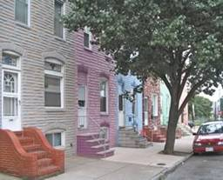
SSI Benefits for Adults
Don’t Count as Resources
Home you live in
Primary automobile
Burial plots
Certain resources set
aside for personal burial
expenses

Slide 9
Exclude Burial Items from SSI
$1500 designated for Burial (must sign a form designating the funds)
Burial space items including cemetary lot, markers, caskets, vault, headstones and other pre-paid items
Some pre-paid burial contracts

Slide 10
ABLE Account Eligibility
To be eligible, individuals must meet two requirements:
Age Requirement:
Had an onset of disability prior to 26th birthday
2. Severity of Disability
Determined to meet the disability requirements for Supplemental Security Income (SSI) or Social Security Disability Insurance (SSDI)and are receiving these benefits
Or
Obtained a disability certification, including a licensed physician’s diagnosis, that the individual meets certain severity of disability criteria
Notes:
SSI stands for Supplemental Security Income. Social Security administers the SSI program, which pays monthly benefits to adults with limited income and resources who are disabled, blind, or age 65 or older. Blind or disabled children may also get SSI.
People who have worked long enough, recently enough, may be able to receive Social Security benefits – such as disability or retirement – and SSI benefits at the same time, if the amount of Social Security benefits in combination with the person’s other income falls below the SSI income limits.

Slide 11
ABLE and SSI
The first 100,000 in an ABLE account does not count as a resource for SSI
SSI monthly payments will be suspended if the beneficiary’s ABLE account balance exceeds $100,000 by an amount that causes the recipient to exceed the SSI resource limit, but SSI eligibility will not be terminated.
Social Security counts housing expenses as a resource if they are distributed in one month and held until the following month.

Slide 12
Using ABLE Account Funds
Distributions from an ABLE account may be made for “Qualified Disability Expenses.” These distributions do not count as income. If they are spent in the month received, there is no effect on SSI eligibility.
Qualified disability expenses:
Relate to the designated beneficiary’s blindness or disability
Are for the benefit of that designated beneficiary
Must relate to maintaining or improving his or her health, independence, or quality of life

Slide 13
SSI Trust Determinations
Social Security must make a Trust Determination (some Trusts require a precedent such as a pooled trust)
We have different rules for Trusts established before 1/1/2000 and Trusts established after that date.
Process:
Claims Specialist makes initial determination
Submit determination to Regional Trust Reviewer
If they disagree on the determination it goes to a Regional Trust Leads Person to make a determination
Some Trusts may need a legal opinion from our Regional Chief Counsel

Slide 14
To make a determination we need the following information:
A copy of the trust document;
Copies of any signed documents between organizations making payments to the individual and the individual legally entitled to such payments, if the payments have been assigned, either revocably or irrevocably, to the trust or trustee;
Source of assets funding the trust;
Records of any payments or disbursements (such as ledgers and bank statements) from the trust, as necessary; and
Any other pertinent documents, such as court documents.

Slide 15
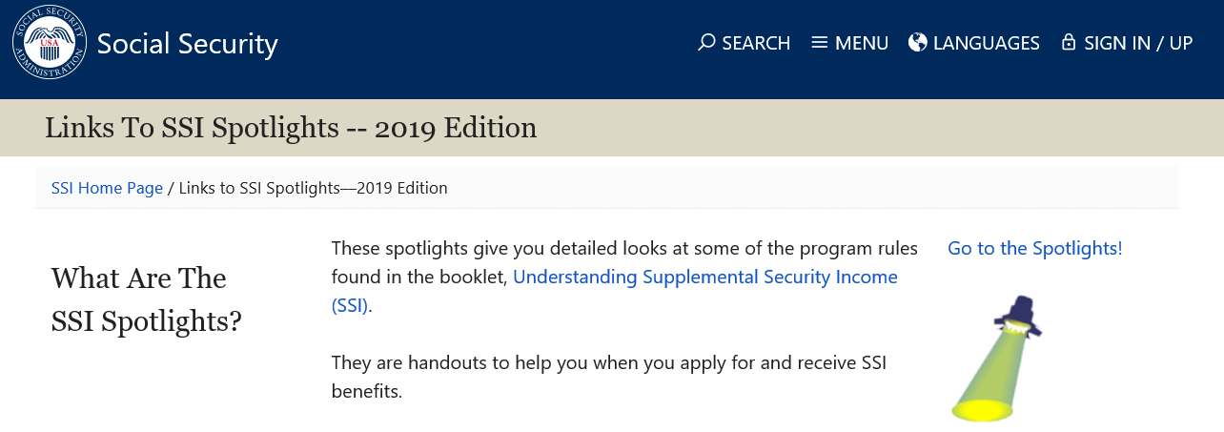
www.ssa.gov/ssi/links-to-spotlights.htm#links

Slide 16
Q&A session
Patty Hoffman and Jamie Jacobson
Social Security Administration
4207 Boulder Ridge Road
Bismarck ND 58503
877-319-6044
Notes:
Option for speaker:
You can use this slide OR switch to the visual “Rotating Brand Images” presentation found on the PARC as a scrolling visual while answering questions.

