Slide 1

Poly-victimization and the Prevention of Elder Abuse
Sherry Hamby
Life Paths Appalachian Research Center and
University of the South, Sewanee, TN, USA
Collaborators: Victoria Banyard, John Grych, Elizabeth Taylor,
Laura Mosqueda, Alli Smith
I’d also like to acknowledge the assistance of many research assistants.
Especially, I would like to thank the many community members who have shared their stories.
Presented at “Ensuring Trust: Strengthening Efforts to Protect Vulnerable Adults,” Bismarck, ND, April, 2019. sherry.hamby@lifepathsresearch.org or sherry.hamby@sewanee.edu

Slide 2
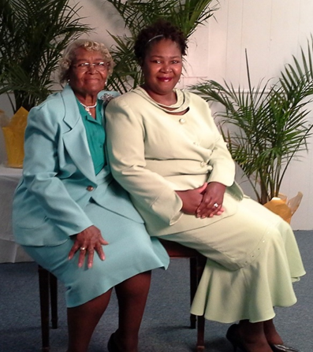

Topics We Will Cover Today
Poly-victimization and the lifelong impact of the cumulative burden of early childhood adversity
Resilience portfolios and strategies to help people thrive and be safe despite high burdens of adversity.
A strengths-based approach to elder abuse prevention, with a focus on helping vulnerable adults with dementia and other conditions affecting their independence.

Slide 3
The pervasiveness of adversity
From Hamby et al., 2018

Slide 4
The Web of Violence
Child Physical Abuse
Dating Violence
Community physical assault
Intimate Partner Violence
Child Neglect
Robbery
Sexual Assault & Rape
Child Sexual Abuse
Bullying
Exposure to community violence
Gang violence
Elder Abuse
Hamby & Grych, 2013

Slide 5
Elder Abuse is Only One Type of Late Life Victimization
Financial exploitation
Caregiver maltreatment
Property crime, scams
Identity theft
Sexual victimization
Witnessing abuse of children & grandchildren
Conventional crime
Adult bullying & bias crime
See review in Hamby, Smith, Mitchell, & Turner, 2016

Slide 6
Interconnections in Representative Community Samples
Interconnection | Strength of association (OR)
Well-known, well-established connections | Odds ratio
Exposure to IPV & child physical abuse | 5.0 ^{(NatSCEV; Hamby et al 2010)}
Exposure to IPV & teen dating victimization | 3.8 ^{(NatSCEV; Hamby et al 2010)}
Physical IPV & Stalking by intimate partner | 7.0 ^{(CDC, Krebs et al, 2011)}
Physical IPV & sexual violence by intimate partner | 2.4 ^{(CDC, Krebs et al, 2011)}
Strong but under-recognized connections
Exposure to IPV & neglect | 6.2 ^{(NatSCEV; Hamby et al 2010)}
Exposure to IPV and sexual abuse by known adult | 5.2 ^{(NatSCEV; Hamby et al 2010)}
Any physical assault & any sexual victimization | 6.2 (NatSCEV, Finkelhor et al, 2009)
Any witnessed violence and any sexual victimization | 4.5 (NatSCEV, Finkelhor et al, 2009)
Teen dating victimization and peer sexual harassment | 5.3 ^{(NatSCEV; Hamby et al 2012)}
Weaker but still positive connections
Exposure to IPV and peer relational aggression | 1.7 ^{(NatSCEV; Hamby et al 2010)}
Any property crime and any sexual victimization | 3.2 (NatSCEV, Finkelhor et al, 2009)

Slide 7
Trauma Symptom Levels by Total Number of Victimization Types*
N=4549 from nationally representative sample covering experiences of youth 1 month to 17 years; Finkelhor, Turner, Ormrod, & Hamby, 2009 (replicated twice with new national samples).
* cases with 11+ victimizations aggregated due to smaller Ns.
** mean standardized symptoms scores at different numbers of victimization types, controlling for demographic variables

Slide 8
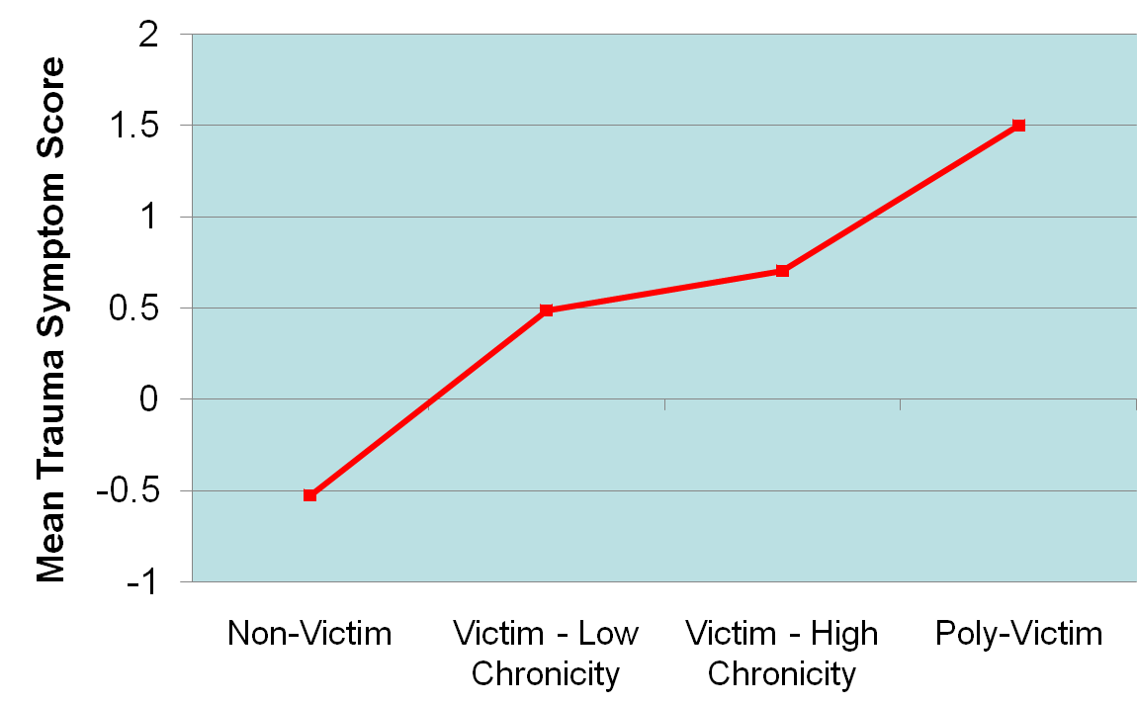
Comparison of Trauma Symptoms across 4 Groups:
Non-victims, Maltreatment Victims (Low Chronicity), Maltreatment Victims (High Chronicity), Poly-victims
Notes:
8

Slide 9
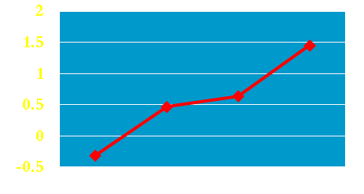
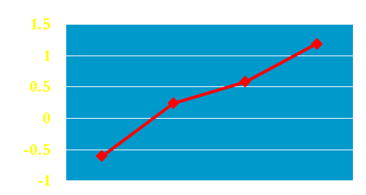
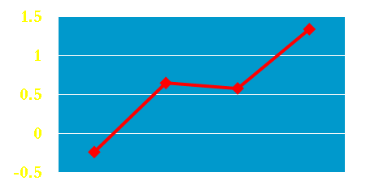
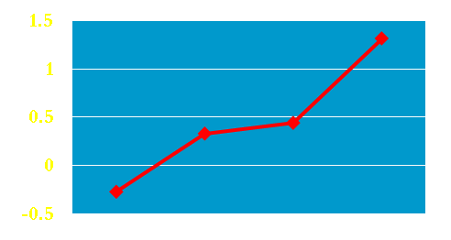
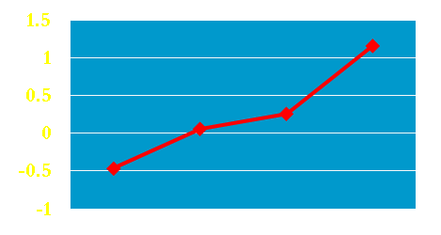
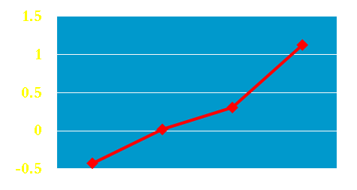
Trauma Symptom Scores across Victim Groups
Property Crime Victims
Maltreatment Victims
Peer-Sib Victims
non-vic
vic – poly vic
non-vic
vic – poly vic
non-vic
vic – poly vic
vic – low chron
vic – high chron
vic – low chron
vic – high chron
vic – low chron
vic – high chron
Sexual Offense Victims
Witness Family Violence Victims
Witness Community Violence Victims
non-vic
vic – poly vic
non-vic
vic – poly vic
vic – low chron
vic – high chron
vic – low chron
vic – high chron
non-vic
vic – poly vic
vic – low chron
vic – high chron
Notes:
9
Decline in sexual abuse occurring at the same time as declines of other indicators of crime and social pathology, some of which could be related. Some of these crimes and problems have close connections to sexual abuse, like the rape rate, the female intimate partners. Some of these indices are valuable comparisons because they are not “official reporting” or “intervention” measures like the NCCANDS, they are self-reports like the NCVS.
Sexual Abuse—NCANDS: 31% decline
Teen Birth Rates per 1,000 females ages 15-17—KIDSCOUNT: 13% decline
Percentage of Children in Poverty-- Federal Interagency Forum on Child and Family Statistics: 18% decline
Total Violent Crime per 1,000 persons—NCVS: 30% decline
Rape Victimization per 1,000 persons—NCVS: 60% decline
Female Victimization by Intimate Partners per 1,000 women—NCVS: 21% decline
Describe that correlations were run on a number of different variables at the state-level and no significant correlations were found
Physical abuse (.69*), Forcible rap (.08), Aggravated assault (.05), Intimate partner homicide (-.11), Child poverty (-.01), HS drop-out rates,(-.08), Teen birth rate (.03), % Single parent households ( .11), Teen suicide rates (-.07), Parent Unemployment rates (.01),“CAC index” ( .24)

Slide 10
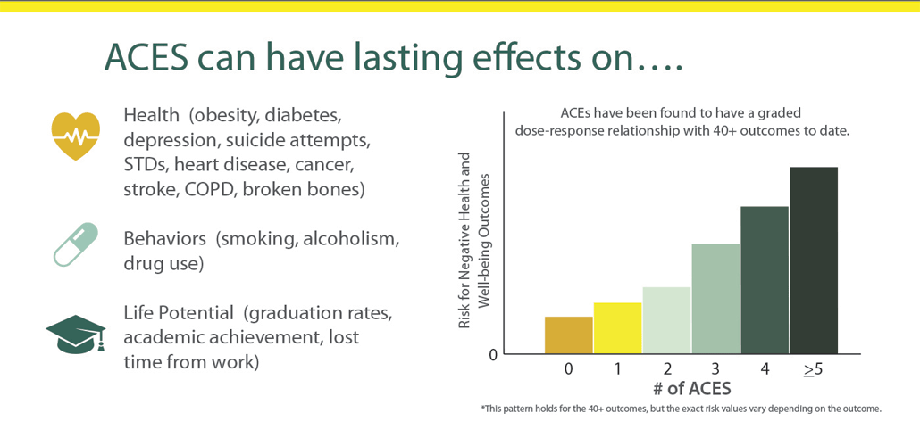
A similar model, Adverse Childhood Experiences, has extended this research to late adulthood
Original ACEs study sample age range from 19-92, average age 56 years (Felitti et al., 1998)
Graphic from CDC

Slide 11
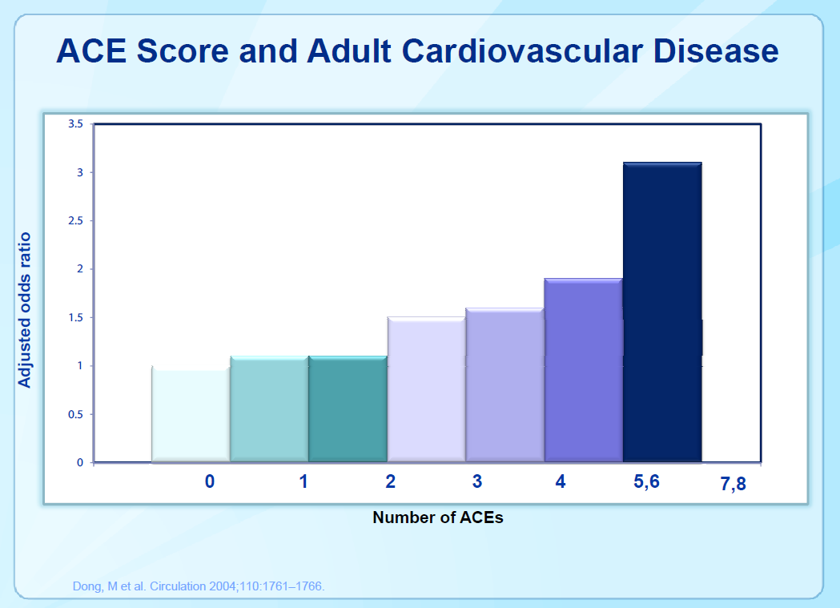
Childhood Adversity Lasts A Lifetime
Dong et al, 2004, separate sample of over 17000 adults, average age also 56

Slide 12
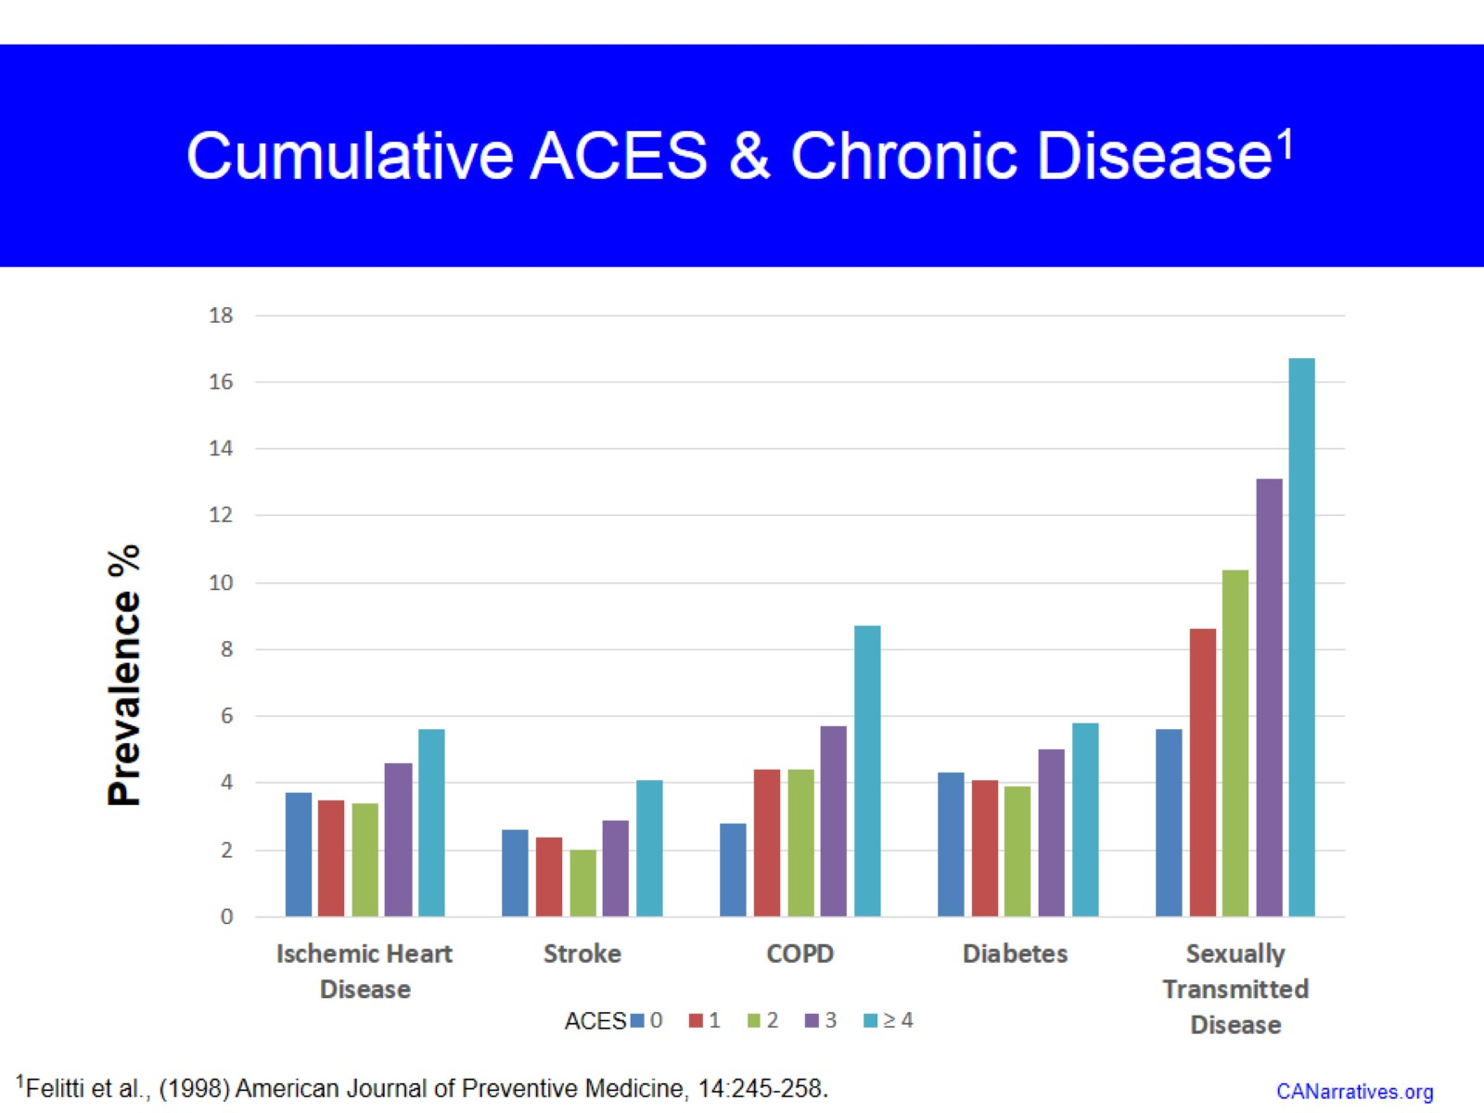

Slide 13
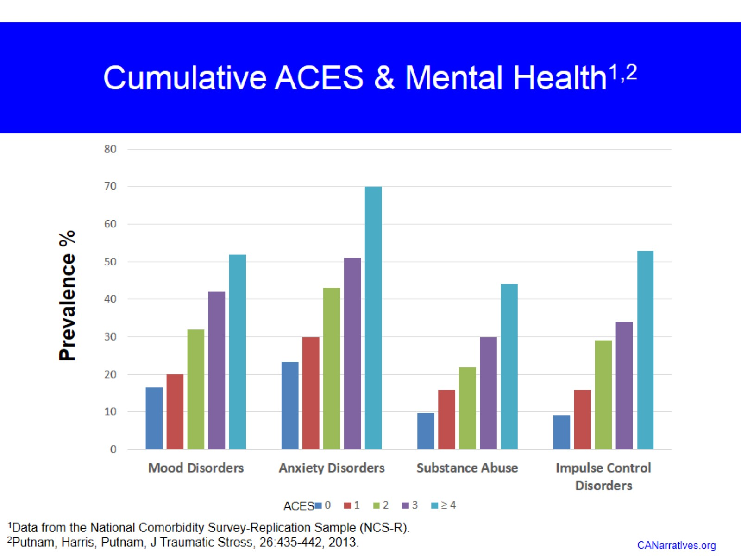

Slide 14
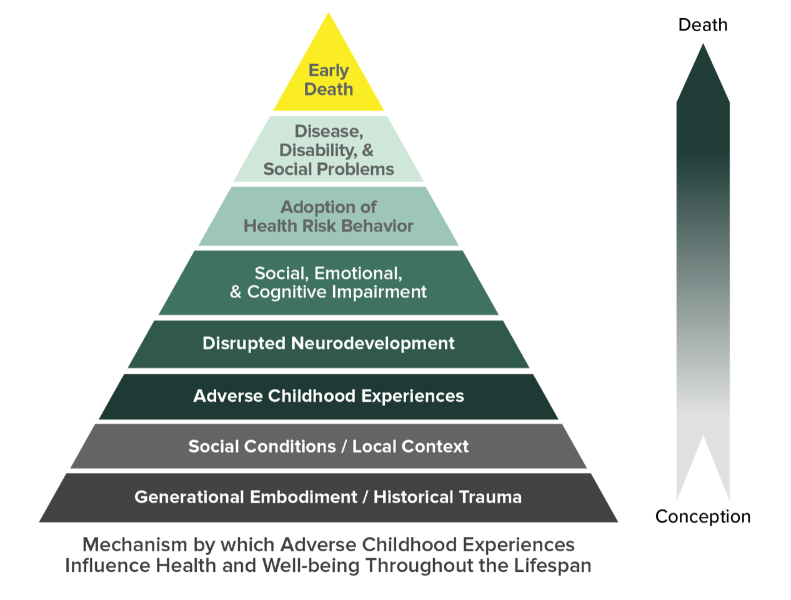
How Poly-Victimization Is Carried Into Late Life

Slide 15
Resilience Portfolios

Slide 16
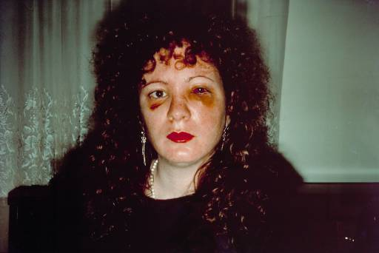

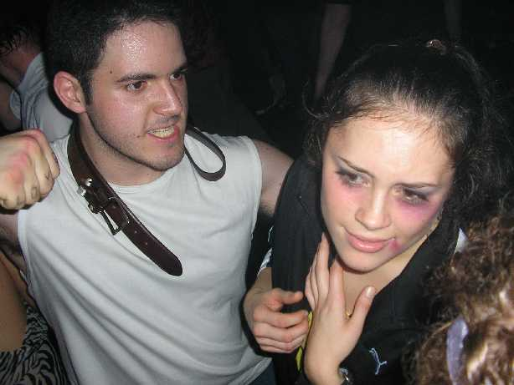


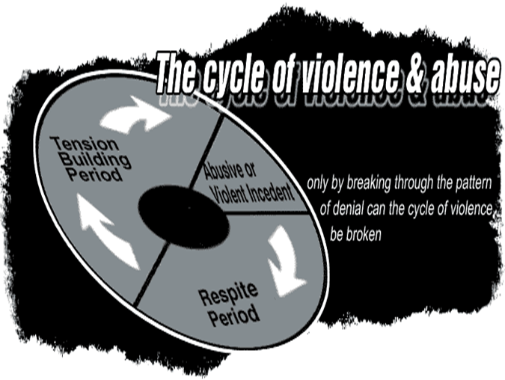



“intentional game players”
“compliant zombies”
“masochistic self states”

Slide 17
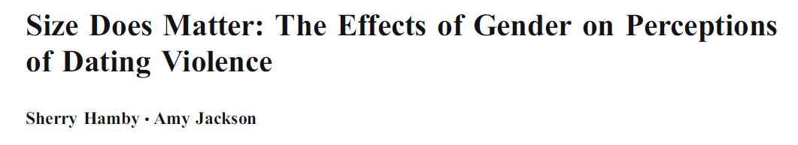

Slide 18

Resilience is “ordinary magic”—Anne Masten
Sooner or later, almost everyone who survives to adulthood will experience a significant adversity.
Yes, there are lifelong mental and physical health burdens from trauma.
Nonetheless, resilience is also not rare!
Resilience is a PROCESS, which involves applying our assets and resources (individual, family, and community) to coping when we experience adversities.
  The goal is to achieve thriving despite adversity.
  These 3 elements---adversities, strengths, outcomes—are all necessary for understanding resilience.
Most people who experience adversity will never meet clinical criteria for a psychological disorder.
  For example, even after 9/11, the rate of PTSD in NYC was less than 10%.
Many of the most impressive and accomplished people have experienced extraordinary levels of traumatic events.

Slide 19
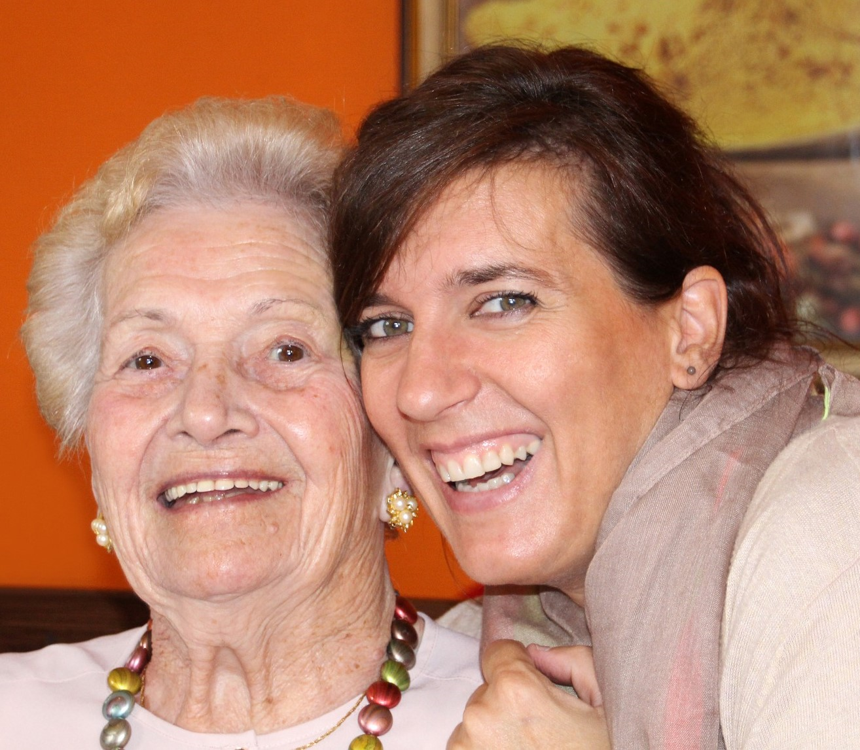
Resilience Portfolios
The objective of the Resilience Portfolio approach is to identify the most important strengths and protective factors for achieving well-being after adversity.
We define resilience as achieving well-being and thriving after adversity, by using strengths (assets and resources) to counter the effects of adversity.
We assess different aspects of adversity, strengths, and well-being to topple “silos.”
From Grych, Hamby, & Banyard, 2015; Hamby et al., 2017; 2018

Slide 20
Innovations of Resilience Portfolio Model
Focuses on:
Malleable characteristics.
Under-appreciated strengths
Thriving, not just absence of pathology
Multiple elements of the social ecology (individual, peer, family, community)
“Poly-strengths” (diversity) and density of strengths.
Informing prevention and intervention. If you have limited time and resources with a client or group, what are most important targets? Emotional regulation or social support? A sense of purpose or compassion?
Head-to-head comparisons of strengths to guide the best use of resources for prevention and intervention.

Slide 21
Good Stuff is More Important Than Bad Stuff
“Other” are things such as daily ups and downs and impact of therapy.
From Hamby et al., 357 adults up to age 76

Slide 22
The Resilience Portfolio Model
RESOURCES & ASSETS:
Personal strengths
SES
Caregivers (kids)/Partners (adults)
Safe, stable environment
Community, culture
Cognitive abilities
WANT TO MINIMIZE THE HARM OF PAST ADVERSITY? FOCUS ON THESE TARGETS
WANT TO PREVENT ADVERSITY? FOCUS HERE
COPING RESPONSES:
(What you do) Coping, including appraisal, regulatory behavior, meaning-making behavior
ADVERSITY:
Victimization, loss, illness/injury, other life events
WELL-BEING:
Physical, Psychological, Multiple dimensions of Well-Being
Banyard, Hamby, & Grych, 2016; Grych, Hamby & Banyard, 2015; Hamby, Grych, & Banyard, 2018

Slide 23
Psychological status is well-maintained in healthy aging

Slide 24

Older Adults Reported Higher Levels of Some Strengths Than Younger Adults
Continue climbing into the 50s, 60s, and 70s:
  Sense of purpose
  Psychological endurance
    (Persevering through difficulties, staying true to oneself and one’s values despite adversity)
  Religious meaning making
Photo: Pixabay
Data from 2 samples in southern U.S., total n over 800, with more than 200 participants age 50 or over; Hamby et al., 2018

Slide 25
Many Psychological Strengths are Stable Across Adulthood
Some are lower during adolescence, but are relatively stable by late 20s/early 30s and remain stable or even increase slightly in later years (especially regulatory strengths)
  Impulse control
  Compassion
  Recovering positive affect
  Self-reliance
Some are relatively stable across lifespan from adolescence through adulthood (especially interpersonal strengths, which are typically the first to develop in adolescence)
  Perceptions of community support
  Group connectedness
  Relational accountability
  Mattering and appreciation

Slide 26
What Promotes Resilience?
For the most part, the same things help older adults as younger adults
Poly-strengths
Recovering positive affect
Self-reliance
Purpose
Endurance
Community support
Mattering
Strengths
Adversities
Poly-victimization
Financial strain
Other adversities
The importance of some strengths declines with age: Impulse control (probably because almost all healthy older people have it), social support received (better at meeting own needs, developmental changes in social networks?)

Slide 27

Key Take-Aways on Poly-Victimization & Resilience
#1. Traditional approaches to elder abuse are missing:
  The true lifelong burden of victimization and the lingering effects into late life of early trauma.
  The many forms of victimization that occur in late life.
#2 Ageist stereotypes are not supported by data.
  Declines in psychological strengths and well-being are not an inevitable part of aging. Just the opposite is true—it is common for people to maintain or strengthen into their 50s-70s and perhaps beyond.
#3 Good stuff counts more than bad stuff!
Photo from Pixabay

Slide 28
Preventing Elder Abuse

Slide 29
Part 1: General Principles & Strategies

Slide 30

What Doesn’t Work: Just Say No to Just Say No
There are not many formal programs for the prevention of elder abuse, but most violence prevention programs (of all types) still tend to focus on red flags and warning signs.
THESE DON’T WORK!!
Some providers hang onto them despite years of evidence that they have little impact.
Such programs might debunk a few myths or increase knowledge, but they don’t have any impact on actual behavior.
The latest innovations in violence prevention in other fields shift away from these old school “admonishment” programs. Finger wagging, “just say no” approaches do not help people when they are in difficulty, emotionally charged situations.
Photo by Gerd Altmann from Pixabay
Similar programs in substance abuse, nutrition, etc are also ineffective.

Slide 31

So What Does Help?
The best way to prevent violence of any type (or, for that matter, poor outcomes in any domain) is to increase people’s resources and assets. This can help insulate them from many risks.
It is not possible to completely eliminate the risk of violence—there is always the risk of some unlikely random attack.
However, by improving people’s portfolio of strengths, we can minimize risks.
Even better, this approach to prevention works best with known caregivers and ongoing relationships (the main class of elder abuse perpetrators).
Image by Sasin Tipchai from Pixabay

Slide 32
Find Their “Why”
The most important step you can take with any client or family is to help them identify their motivations and goals.
For elders:
  Does a grandparent want to be around for grandchildren or other family members?
  Do they want to leave their family a strong legacy?
  Are they still involved with their community, religious organization, or other activity?
For family members, find out why they are motivated to be good caregivers.
  Love and appreciation for the parent?
  Wanting to be a good role model for children or other younger family members?
  A sense of duty? Does it match their idea of what a good person or a strong person does—an identity motive?
  Continue to enjoy the time they spend with their parent or elder? Does this relationship still meet some of their social needs?
The lower functioning the client, the more important it is to take the time to do this step with caregivers.
If they only offer a financial motivation, use MI steps to process.

Slide 33
Identify Strengths
The key element is to adopt a strengths-based approach.
This means defining goals in positive terms—”Live a full life with the time I have left”—instead of negative ones—”Avoid being abused.”
Positive goals are important for caregivers too, esp those caring for vulnerable adults with severe dementia or other cognitive impairment.
It also means acknowledging strengths, and not just focusing on presenting problems or symptoms.
  External resources such as housing, caregivers, established relationships with health care providers, social connections in community and with extended family
  Personal assets such as ability to do self-care, activities of daily living, physical mobility, psychological strengths
Consider home visitation. There’s no better way to do an assessment of strengths and needs. Home visitation programs have good track records for falls prevention, medication management, and other pieces that need to be in place to reduce the risk of elder abuse.

Slide 34
Motivational Interviewing

Slide 35
The “Spirit” of Motivational Interviewing
Partnership
o Recognize that everyone is an expert in their own lives
o Ask permission
o Focus on mutual understanding versus the provider being right
Acceptance/Autonomy/Absolute Worth
o Provider is a guide, but people must make their own decisions to change
o Respect patient autonomy – whether or not they change
o See ambivalence as normal
Compassion
o Genuine care and concern
o Understand and validate the struggle
Evocation
o Instead of telling people what to do, evokes person’s own motivation and resources for change
o Trust patient to be motivated for something
o Avoid expert trap
You may not remember all of the processes and techniques of MI, but if you incorporate the Spirit of MI in all of your interactions with patients, you would have gone a long way in making a difference.
MI slides adapted from Community Care of North Carolina

Slide 36
ROLL WITH RESISTANCE
IMPORTANT!
The resistance or disconnect a person offers can be turned or reframed slightly to create a new momentum toward change. The object that is in motion here, expressed as resistance, is not a person but a perception. So, roll, flow with it; no need to oppose.
• Avoid arguing for change (unnecessary stress for you and stress for the patient).
• It is a signal to RESPOND DIFFERENTLY, slow down…listen...breathe.
Examples:
“It sounds like you have tried before and it hasn’t worked for you.”
“On the one hand, it seems you recognize there are some real problems here I’m trying to help with, and on the other hand, what I am suggesting is just not acceptable for you right now.”

Slide 37
Key Element: Develop Discrepancy
Change is motivated by a perceived discrepancy (difference) between present behavior and a person’s important goals and values. Developing discrepancy should be done in a non-judgmental way.
Common techniques used to create or develop discrepancies include:
• Asking the person to look into the future and imagine a changed life under certain conditions (i.e., condition is well managed) or to look into the past and recall periods of better functioning.
• Ask the person to consider the worst possible scenario resulting from not changing behavior or the best possible consequences resulting from trying to change. Reflect any movement toward change.
• Ask questions about behaviors that don’t support goals set by the patient. Present discrepancies as legitimate conflicts or mixed experiences rather than as contradictions or judgments that prove person has a problem.
Example: “On one hand I hear you saying that you would like to walk your grandson to the bus stop in the mornings, and on the other hand you said it is hard for you to get up in the morning if you haven’t been taking your medications regularly.”

Slide 39
Evoking : Exploring Pros and Cons

Slide 40
EARS: Responding to Change Talk
When you hear Change Talk, don’t just sit there…you should be all EARS:
• Explore
o “What other benefits can you think of?”
o “What else could you do if you felt better?”
• Affirm
o “It’s great that you are talking about making that step.”
o “You’ve done hard things before; it seems you can accomplish things once you decide.”
• Reflect
o “So making this change could really affect your goal of your child’s asthma being better controlled.”
• Summarize
o “You listed a lot of reasons to change. I heard…”

Slide 41
Part 2: Key Domains of Elder Abuse Prevention

Slide 42
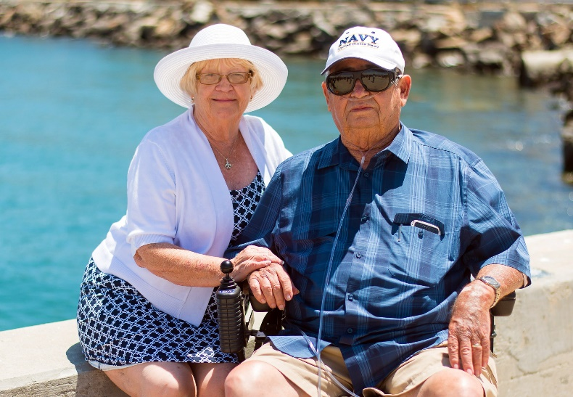
Thriving is Not Just Avoiding Abuse
DOMAINS:
Home Safety
Physical Health
Psychological Well-Being
Social Connections
Financial Well-Being
Spiritual Well-Being
Photo by Kim Heimbuch from Pixabay
Some material adopted from the EMPOWER elder abuse prevention project headed by Jeanette Hussemann and Jennifer Yahner of the Urban Institute, with Sherry Hamby, Tony Rosen, Pamela Teaster, & Melissa Elliott, as well as the taxonomy of outcomes in the Resilience Portfolio Model, Hamby et al, 2018.

Slide 43

Considerations for Vulnerable Adults
All of these domains can be addressed for people at all levels of functioning.
Most prevention strategies can be adapted for people with Alzheimer’s and other dementias that affect memory and language, or for people who have mobility or other physical issues.
As levels of impairment increase:
  It is more important to focus on the physical and social environment to support the older person.
  It is more important to focus on sustaining caregivers, many of whom may be in late life themselves.
Pixabay

Slide 44
Home Safety
One key to preventing elder abuse is to keep older adults healthy and independent for as long as possible. Changes in power dynamics, sudden increases in caregiver burden, and a victim’s decreasing ability to resist are major risk factors for abuse.
Reducing common stressors is an important prevention strategy!
An environmental scan of the home is a powerful tool. Many people do not modify their homes as they age to reflect their changing needs.
Seemingly small things like adding night lights and picking up loose throw rugs can increase the safety of the home.
Other relatively simple modifications such as grab bars in the bathroom or seats for the shower can also have significant payoffs relative to their cost.
Older adults may need help cutting down on stuff so there are clear lanes of traffic. May need to transition to smaller pets.
Avoiding accidental falls and broken bones are not only good in and of themselves, they are also elder abuse prevention.

Slide 45
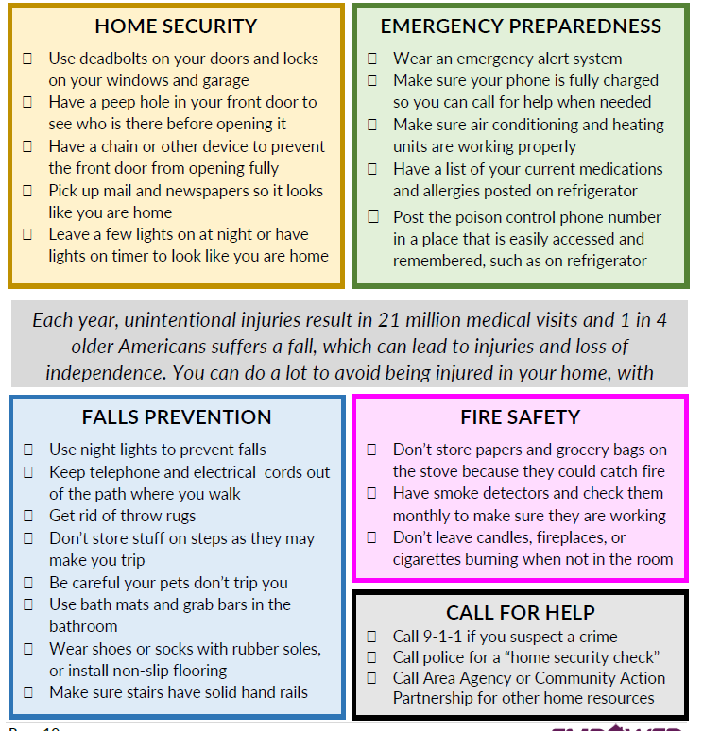
Checklist from EMPOWER

Slide 46



More relatively easy & low-cost home hacks
Add risers to sofas (makes it easier to stand up)
Be sure there is contrast between steps and floor (not carpeted in all same color, hard to see)
Make sure chairs have arms
Consider hotel-style lamps with switches on the base (instead of having to reach and turn small knob)
Change light switches to wider ones that can be opened with fist
Paint inside of kitchen or other cabinets a light color so it is easier to see inside (will reflect more light).
Install liquid soap dispenser in showers (no more bending over for soap)
Change doorknobs to lever style—easier for arthritis etc
Remove cabinets from under bathroom sinks to make wheelchair accessible
Add benefit: These simple changes can be relationship strengthening too. Older person feels cared for, caregiver feels less helpless.
From AARP

Slide 47
However, remember the goal is independence, not dependence
These changes should help people continue to navigate spaces comfortably as their mobility and flexibility change.
By helping them maintain or increase current levels of activity, these modifications can promote health and well-being.
It is important to avoid/postpone “frailty syndrome” for as long as possible.
However, do not make changes that lead to less activity.
  For example, do not encourage wheelchair use unless it is needed.
  Do not do things for them that they can do for themselves.
    Let them use kitchen, don’t put a toilet seat in the bedroom, encourage them to move around.
Use it or lose it

Slide 48
Physical Health
Physical health is also key to supporting safety and well-being.
Sample strengths-based questions (from EMPOWER):
  What are you most proud of when it comes to taking care of your health?
  How do you handle physical conditions or disabilities you’re facing?
  Are there things you would like to change about your healthcare? What are some ways you can be more in control of your health?
Other topics to address: diet (especially if on low sugar or low salt diets), substance use (alcohol and drugs), vision, dental.
Emergency plans (emergency contacts, living will, etc)
Physical Health Record (see next slides) from AARP in English & Spanish: https://www.aarp.org/health/drugs-supplements/info-2007/my_personal_medication_record.html

Slide 51
Psychological Well-Being
People can still develop psychosocial strengths in late life—use MI techniques and assess for strengths and areas they would like to improve.
Be prepared to help people deal with grief and loss.
  However, never confront or argue with someone who does not remember that someone has died because of dementia. It will only upset them and they will not be able to retain the information.
Be on the lookout for signs of depression or suicidality. These can contribute to a negative spiral of interactions that also increase risk of abuse (which then makes depression worse, and so on).
Emotional support offers older adults the affection and companionship we all long to receive.
Tangible support provides behavioral or financial assistance, such as someone who can bring you groceries, drive you to the doctor, or help you pay for a home repair.
Older adults’ perceptions of social connectedness matter more than the number of connections in their network. They may be content with one close friend, or happy interacting with old friends over social media. Do not judge their social connections by the standards of younger people.

Slide 52
Preventing Financial Exploitation & Supporting Financial Well-Being

Slide 53
Most Estimates of Financial& Other Cyber Crimes Are Far Too Low
From Hamby, Blount et al., 2018, using a more comprehensive measure of cyber-victimization in a sample of 478 adolescents & adults

Slide 54
Common Ways Family Members and Trusted Others Exploit Vulnerable Adults
Use Power of Attorney, given by the victim to allow another person to handle victim’s finances, then steal victim’s money for the perpetrator’s own use
Take advantage of joint bank accounts in the same way
Use ATM cards and steal checks to withdraw money from victim’s accounts
Threaten to abandon, hit or otherwise harm victim unless perpetrator gets what they want
Refuse to obtain needed care and medical services for victim to keep the person’s assets available for abuser
In-home care providers charge for services; keep change from errands, pay bills which don’t belong to the vulnerable adult, ask vulnerable adult to sign falsified time sheets, spend work time on phone/not doing what they are paid to do
Source: National Adult Protective Services Association

Slide 55
Common $ Scams by Strangers
Lottery & sweepstakes scams “You’ve already won! Just send $2,500 to cover your taxes”
Home repair/traveling con men “We’re in your area and can coat your driveway / roof really cheaply”
Grandparent scam: You’re called and told your grandson is in jail and needs you to send money immediately
Charity scams: falsely soliciting funds for good causes; very common after disasters
I’m from the utility company; I need you to come outside with me for a minute (while accomplice steals valuables)
Roof repair, yard work, home repair scams
Telemarketing scams and accompanying threats
Money sent via telegraphs to people claiming lottery winnings

Slide 56
Common Scams by “Professionals”
Predatory Lending – seniors pressured into taking out inappropriate reverse mortgages or other loans
Annuity sales – the senior may be pressured into using the equity realized from a reverse mortgage (or other liquid assets) to buy an expensive annuity which may not mature until the person is well into their 90’s or over 100
Investment/securities schemes – pyramid schemes; unrealistic returns promised; dealer is not licensed
Internet phishing – false emails about bank accounts
Identity theft – credit cards opened fraudulently, etc.
Medicare scams – these are the costliest in terms of the dollar amounts

Slide 57
Prevention & Intervention For Financial Abuse
Most importantly, older adults need to be aware that the world has changed. People do not contact each other over the phone as much (texts have passed phone calls) and legitimate businesses almost never use the telephone.
You can help prevent financial exploitation:
  Encourage families to work out a realistic budget.
  Encourage families to talk to their health care provider before purchasing medical equipment and to buy medication only from licensed pharmacies.
  Encourage families to sign up for a credit monitoring service such as Credit Wise or get free annual credit reports (www.annualcreditreport.com).
  Encourage people to review bills & receipts, and read contracts carefully—or get help with these.
  Help clients look up businesses or phone numbers on Google or other search engine.
To intervene after financial abuse has occurred:
  Help victim close joint bank accounts
  Help victim revoke the power of attorney
  Put in place a responsible person or agency to assist with managing the victim’s funds
  Restart utilities if they’ve been shut off.
  Refer cases to law enforcement for investigation and prosecution.
  Include law enforcement and banks on multi-disciplinary teams

Slide 58
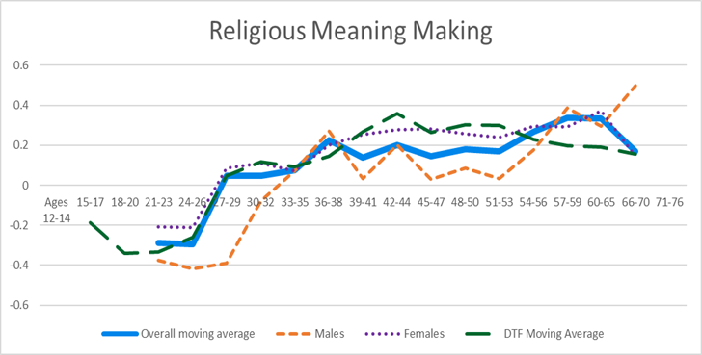
Spiritual Well-Being
Religious meaning making increases more than any other strength as we age.
Religious involvement can mean personal faith or involvement in churches, synagogues, mosques, or other religious organizations.
Religious organizations often offer both emotional and tangible support.
Tangible support can include visiting sick members of the congregation, providing rides to doctor, meals, etc.
Although state and community services are appropriately secular, it is helpful to know what kinds of support they might wish to have or are receiving from religious organizations.

Slide 59
Other Evidence-Based Interventions That Promote Strengths & Support Thriving
Mindfulness meditation
  Supports compassion, emotional awareness, emotional regulation
Regular exercise (and other routines, including sleep!)
  Supports psychological endurance, optimism, reduces depression & anxiety
Volunteering
  Promotes generativity, community support, meaning
Spirituality and religious involvement
  Promotes purpose, social support
The evidence base is steadily increasing for other interventions, such as yoga, gardening, activism as healing, even “forest-bathing”
People with Alzheimer’s or similar dementias that affect memory and language (especially during mild and moderate stages) can benefit from physical and nonverbal activities such as walking, gardening, listening to music from their youth, dancing, reminiscing
There are a range of choices that can be tailored to clients’ interests and needs and incorporated into a wide variety of service settings.

