Slide 1

NGA Ethical Principles, Standards of Practice,
and Fundamentals of Guardianship:
How They Fit Together
Sally Hurme, JD
Ensuring Trust: Strengthening Efforts to
Protect Vulnerable Adults
North Dakota Guardianship Conference
April 8-9, 2019

Slide 2
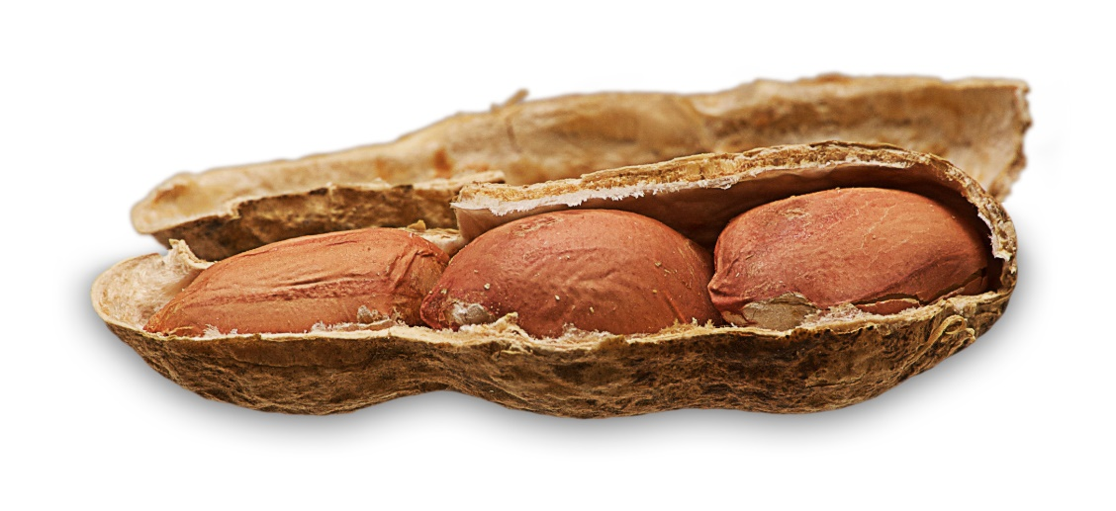
Ethical Tools for Guardians
10 Ethical Principles
  Overarching concepts
  Found throughout Standards
  Distill key factors
25 Standards of Practice
  Elaborate on Ethical Principles
  More “how-to”
Fundamentals of Guardianship
  Training manual

Slide 3
Touch of History
2001: first Standards version
2004: extensive Standards revisions
2011: 3rd National Summit on
Guardianship Excellence in Salt Lake City

Slide 4
Guardianship Summit
Follow up
  1989 Wingspread Conference
  2001 Wingspan Conference
National experts from all disciplines
  Law, Aging, ID, MH, Courts, National Groups
Purpose
  Revisit and refresh best practice standards

Slide 5
Key Summit Resolutions
  Focus on HOW guardians make decisions
  Person-centered philosophy
  Preserve dignity/Treat with respect
  Understand the person’s goals, needs, preferences
  Avoid conflicts of interest
  Monitor and act on changes in capacity

Slide 6
Summit Follow-up
2014 Revise Standards of Practice
2016 Develop Ethical Principles
2017 Revise Fundamentals of Guardianship
All are intertwined
Vary in level of detail

Slide 7
10 Ethical Principles
Treats the person with dignity.
Involves the person to the greatest extent possible in all decision making.
Selects the option that places the least restrictions on the person’s freedom and rights.
Identifies and advocates for the person’s goals, needs, and preferences.
Maximizes the self-reliance and independence of the person.
Keeps confidential the affairs of the person.
Avoids conflicts of interest and self-dealing.
Complies with all laws and court orders.
Manages all financial matters carefully.
Respects that the money and property being managed belong to the person.

Slide 8
Ethical Principle
Ethical Principle #8
A guardian complies with all laws and court orders.
Code prevails when it says something but generally does not give guidance
NGA “guardian” = guardian and conservator

Slide 9
Ethical Principle
Ethical Principle #1
A guardian treats the person with dignity.

Slide 10
Ethical Principle
Ethical Principle #2
  A guardian involves the person to the greatest extent possible in all decision making

Slide 11
ND Century Code
ND Century Code 30.1-28-12(5)
When exercising the authority granted by the court, the guardian shall safeguard the civil rights and personal autonomy of the ward to the fullest extent possible by… Involving the ward as fully as is practicable in making decisions with respect to the ward's living arrangements, health care, and other aspects of the ward's care

Slide 12
Standard of Practice 9
Provide every opportunity to exercise individual rights capable of exercising relating to personal care and financial needs
Participate to maximum extent all decisions
Act on own behalf in all matters in which able
Develop or regain capacity to the maximum extent possible

Slide 13
Ethical Principle
Ethical Principle #3
  A guardian selects the option that places the least restrictions on the person’s freedom and rights.

Slide 14
ND Century Code
ND Century Code 30.1-28-12(5)
When exercising the authority granted by the court, the guardian shall safeguard the civil rights and personal autonomy of the ward to the fullest extent possible by…Ensuring the ward's maximum personal freedom by using the least restrictive forms of intervention and only as necessary for the safety of the ward or others.

Slide 15
How Do You Do It
Code says what
Standards say how

Slide 16
Standards of Practice 8
Be familiar with options
Evaluate available alternatives
Know person’s goals and preferences
Get independent assessments
Pick what best meets personal and financial goals, needs, and preferences
Place least restrictions on freedom, rights, control

Slide 17
Ethical Principle
Ethical Principle #4
A guardian identifies and advocates for the person’s goals, needs, and preferences.

Slide 18
Standards of Practice 9
Best Practice Guardians put the person in the center of the decision-making process:
Use a person-centered philosophy
Develop a plan with person to meet goals and preferences
Person leads planning process

Slide 19
How Do You Do It

Slide 20
Standards of Practice 7
Substituted judgement: make the decision the person would have made if had capacity
NGA Steps
Ask the person
Help person express wishes
Seek input from others about person
Make decision in best interest only if goals and preferences can’t be ascertained

Slide 21
Decision-making Checklist
Is it within my authority
What does the person want
What are the alternatives/options
What are risks and benefits
What if do nothing
What is least intrusive
What action is most congruent with person’s values

Slide 22
Ethical Principle
Ethical Principle #6
A guardian keeps confidential the affairs of the person.

Slide 23
Standards of Practice 11
Respect privacy and dignity, especially when disclosure of information necessary
Limited to what is necessary and relevant
Disclose sensitive information to family unless substantially harm

Slide 24

Standards of Practice 4
Best Practice Guardians:
Maintain person’s social/family network
Maintain communication with family
  Significant occurrences
  Pertinent medical issues

Slide 25
Placement
30.1-28-12(2)
Guardian may establish the place of residence within or without this state.

Slide 26
How Do You Do It

Slide 27
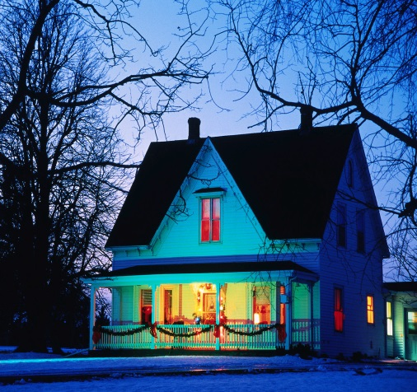
Standards of Practice 12
Best Practice Guardians when making placement decisions:
Support choosing the most appropriate environment
Evaluate all options, fill current needs, serves overall best interests before any move
Prioritize home and community-based
settings
Consider proximity to important people,
activities
Report to court before move if more
restrictive

Slide 28
Medical Decisions
ND Century Code 30.1-38-04(5)
Court's order must state whether the guardian has no authority, general authority, or limited authority to make… medical… decisionmaking.

Slide 29
How Do You Do It

Slide 30

Standards of Practice 14
Best Practice Guardians when making medical decisions:
  Maximize person’s participation in the decision
  Best interest only if preferences unknown and unascertainable
  Choose palliative care in line with person’s values
  Keep those close to the person
  reasonably informed

Slide 31
Fiduciary Duties
ND Century Code 30.1-29-17
Conservator is to act as a fiduciary and shall observe the standards of care applicable to trustees.

Slide 32
Ethical Principle
Ethical Principle #7
A guardian avoids conflicts of interest and self-dealing.
  Self-dealing = take advantage of position as guardian and acts for own interests

Slide 33

Standards of Practice 16
Best Practice Guardians:
  Understand what situations constitute a conflict of interest
  Coordinate services rather than directly provide
  Independent from all service providers
  Sell or buy ward’s property
  Profit from any transaction
  Exemption: If demonstrate unique circumstances, no other entity available, in best interest of person, notified

Slide 34

Examples of Conflicts
Charge for
  Cleaning out
  Moving
  Storing
Hire friends and family
Gifts from providers
NEED TO RECOGNIZE APPEARANCE OF CONFLICTS ON EXAM

Slide 35
Conservator Direction
ND Century Code 30.1-29-25(1)(b)
Conservator expend or distribute sums reasonably necessary for the support, education, care, or benefit of the person with due regard to: (1) Size of estate, the probable duration of conservatorship, and likelihood that the person may be fully able to manage own affairs, (2) The accustomed standard of living of the person, (3) Other funds or sources used for the person’s support.

Slide 36
Ethical Principle
Ethical Principle #9
A guardian manages all financial matters carefully.
Ethical Principle #10
A guardian respects that the money and property being managed belong to the person.

Slide 37

Standards of Practice 17
Best Practice Conservators:
  Allow the person to participate in decisions to the extent able
  Maximize dignity, autonomy, self-determination
  Become educated about the person’s incapacity
  Value the person’s well-being over estate preservation
  Assist person in developing or regaining
  capacity to manage financial affairs

Slide 38
Compensation
30.1-28-12(11) & 30.1-29-14(2)
The guardian and conservator are entitled to receive reasonable sums for services

Slide 39
Standards of Practice 22
Best Practice Guardians:
  Disclose fee structure to
  the court
  Notify if changes
  Explain all fees in annual report/accounting
  Plan for estate exhaustion and report to the court
  May not abandon the person if money runs out
  Criteria for what court considers as “reasonable”

Slide 40
Restoration
ND Century Code 30.1-29-25(5)
When conservator satisfied that the disability has ceased, shall pay over and distribute all funds and properties to the person as soon as possible.

Slide 41
Standards of Practice 21
Work yourself out of a job through restoration
When to do:
  Has developed or regained capacity
  Less restrictive alternatives exist
  No longer benefits the ward
  Expressed desire to challenge necessity
  Dies

Slide 42
Fundamentals of Guardianship
What every guardian should know
Guardianship 101
“How to” carry out the standards
Top of desk as daily reference
Explains all in greater detail
Checklists to help with day-to-day tasks

Slide 43
How to Order
Amazon
www.shopABA.org/guardianship
Call 800 285 2221
Discount code: GUARD20
Price $18.70
Product code 5460220

Slide 44
NGA Standards of Practice
www.guardianship.org/standards

Slide 45
NGA Ethical Principles
www.guardianship.org/standards/

Slide 46
Resources
National Guardianship Association
  www.guardianship.org
Center for Guardianship Certification
www.guardianshipcert.org
National Guardianship Network
  www.nationalguardianshipnetwork.org
ABA Commission on Law and Aging
www.americanbar.org/aging

