Slide 1
ADRL & Lifespan Respite

Slide 2
Aging Services Division
Administers programs and services to enhance the ability of individuals to maintain independence and remain in their own homes and communities.

Slide 3
Aging & Disability Resource Link (ADRL) 1-855-462-5465
Provides current information on opportunities and services available statewide and nationwide, and connects individuals to services to help them maintain or improve quality of life
Contact the ADRL
Call 1-855-462-5465
Call Relay ND 771 (TTY)
Email carechoice@nd.gov
Search online at carechoice.nd.assistguide.net

Slide 4
ADRL Website

Slide 5
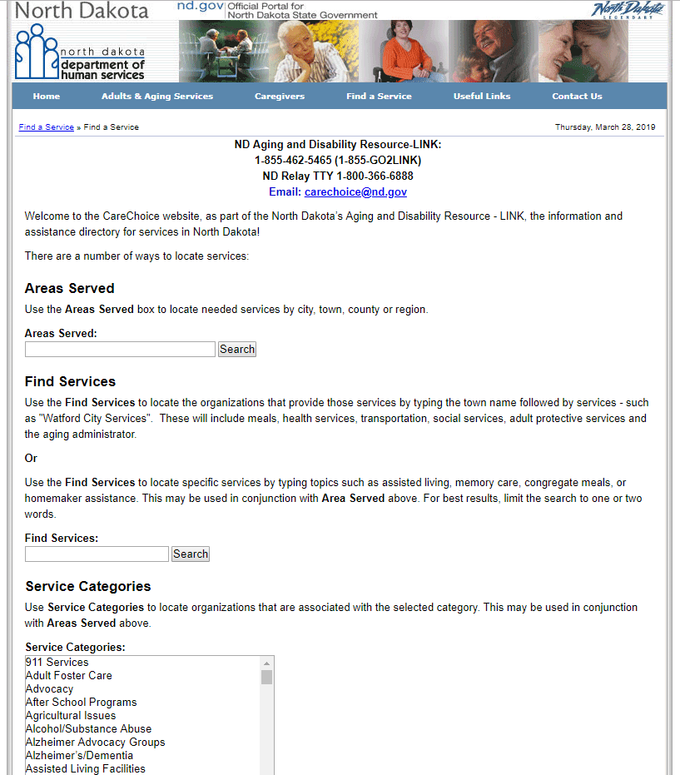
ADRL Website

Slide 6
Respite in North Dakota
43.5 million family caregivers nationwide provide unpaid care to a child or adult with a value of $470 billion annually
Care provided ranges from basic supports (meal prep, transportation) to complex medical tasks (medication administration, tube feeding etc.)
Respite is intended to strengthen the family system while protecting the health and well-being of both the caregiver and care recipient
Respite is a key component of long-term care services

Slide 7
Respite in North Dakota
Why create separate programs just for caregivers?
Because of the physical and emotional effects of caregiving on the caregiver
Because of the potential financial burden
Because most people want to care for, and be cared for, by their family and friends in their own home or community whenever possible
Because of the growing number of caregivers

Slide 8
Family Caregiver Support Program
Purpose:
Offers services for family caregivers to address challenges related to providing 24-hour care
Supports caregivers to continue their caregiving role
Supports caregivers to take care of themselves so the care recipient can remain in the least restrictive environment

Slide 9
Family Caregiver Support Program Eligibility
Family caregivers age 18 and older who are caring for individuals age 60+ who reside with the care recipient (24-hour care)
Grandparents & relative caregivers age 55 and older who care for children age 18 or younger
Grandparents or relative caregivers (excluding the child’s parent) providing care for an adult with a disability between ages of 19 & 59
Individuals 18 and older caring for a person with Alzheimer’s Disease or related dementia, regardless of age of person with dementia
No means testing or fee for services, but participants are offered the opportunity to contribute

Slide 10
Family Caregiver Support Program Service Categories
Information & assistance
Case management
Funding for services
Counseling – up to 4 sessions/enrollment period
Training – to assist caregiver in becoming more confident in caregiving role
Support Groups
Respite Care Services – amount individualized for each caregiver
Supplemental Services – incontinent products or assistive devices

Slide 11
North Dakota Lifespan Respite Grant
North Dakota awarded Lifespan Respite Care Grant in 2017
$200,000
3 year grant ending August 31, 2020
Serves family caregivers regardless of the age of the care recipient
North Dakota Respite Coalition formed to assist with implementation

Slide 12
Lifespan Respite Care Grant Objectives
Explore opportunities and provide education and training on caregiving and respite care for all ages, particularly in rural and underserved areas:
Powerful Tools for Caregivers (PTC) has been expanded and is offered at no cost throughout the state. PTC is provided by NDSU Extension
https://www.ag.ndsu.edu/aging/family-caregivers
Develop a voucher program for emergency respite services
Offer the funding and resources to support caregivers of children with special needs or of adults who have an urgent need for respite care in the absence of any other funding sources

Slide 13
Emergency Respite in North Dakota
Emergency respite for the purpose of the Lifespan Respite Care Grant is:
Any unplanned or unforeseen event or crisis which results in the immediate and unavoidable absence of the caregiver, OR
There is a risk of institutional or higher-level placement of the care recipient if respite services are not provided

Slide 14
Emergency Respite in North Dakota
Emergency respite care services may result from, but is not limited to:
Caregiver illness (physical, mental, emotional)
Caregiver death
Caregiver hospitalization
Illness of a loved one
Funeral/wake
Substance use disorder
Fire/weather damage to caregiver/care recipients’ home
Caregiver/care recipient conflict
Abuse/neglect prevention
Risk of loss of employment

Slide 15
Lifespan Emergency Respite Definitions
Caregiver: Individuals over the age of 18, including family members and foster parents, providing unpaid care to adults regardless of age or the type of disability who need care to meet basic daily needs, or to children who require care beyond that required to meet their basic needs
Care Recipient: An adult, regardless of age or type of disability, who needs care or supervision to meet basic daily needs, or to children who require care or supervision beyond that required to meet their basic needs
Provider: An organization, facility, or individual which provides respite care services. A provider may be a family member who does not reside with the care recipient, a friend, a neighbor as chosen by the caregiver/care recipient/legal representative

Slide 16
Lifespan Emergency Respite Eligibility
Meet definition of caregiver
Caregiver is experiencing an emergency and does not have access to other funding sources or is on a waiting list for available services
Lives with the care recipient
If the primary caregiver does not live with the care recipient, they must be providing frequent on - site visits throughout the day which are essential to assure the care recipient is safe and healthy
Example: the care recipient would be unable to get out of bed, prepare a meal, etc., in the absence of the caregiver
Application for funding must be submitted by agencies

Slide 17
Lifespan Respite Grant
For more information or to apply for emergency respite:
Contact the ADRL
carechoice@nd.gov
855-462-5465
nd.gov/dhs/services/adultsaging/

