Slide 1
INTERVENTIONS
THERAPUTIC
REUNIFICIATION
RESILIANCE
BEHAIVORAL
TIMELINES
HOPE
SELF-SUFFICIENCY
STATES
TRAUMA
DSY
ATTORNEY
FAMILY CENTERED ENGAGMENT
ENGAGING
COMPLEX NEEDS
DRAWING
IDENTIFY
SUPREME
COURT
HOPE
NORTH DAKOTA
DEPRIVED
Dual Status Youth Initiative
SHELTER CARE
UNRULY
QUALITY
GUARDIAN
SUPPORTS
REFERRAL
PARENTS
SUCCESS
JUVENILE COURT
TEAMWORK
VISION
GOAL
LEGAL FINDINGS
IDENTIFICATION
FAMILY
MULTI-DISCIPLINARY TEAM
CHILD WELFARE
TEAM

Slide 2
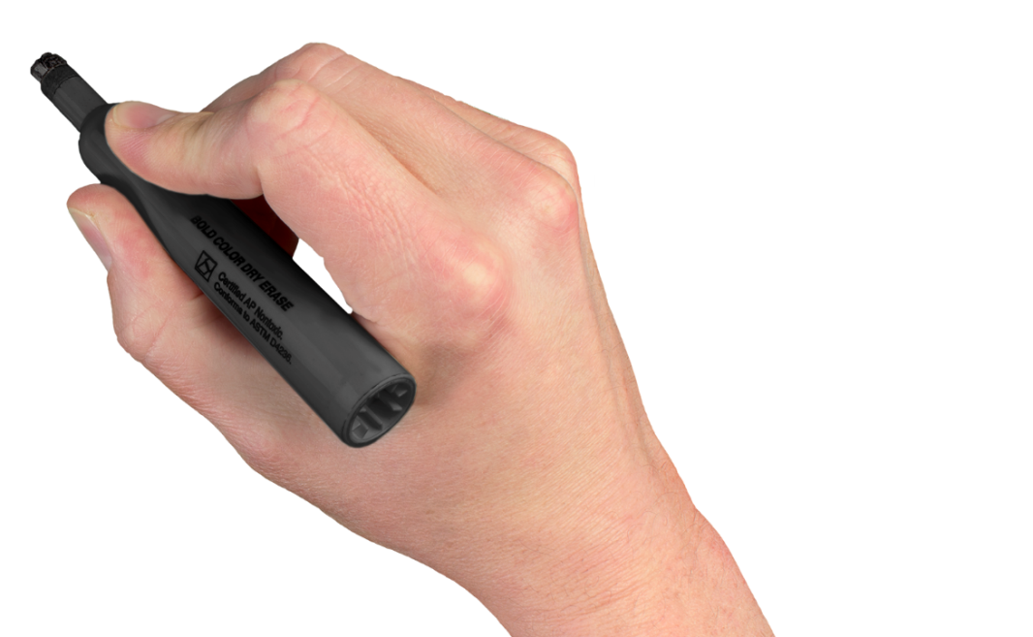
Dual Status Youth Initiative
Children and youth who come into contact with both the child welfare and juvenile justice (delinquency) systems.
child
juvenile
welfare
justice
Notes:
The North Dakota Dual Status Youth Initiative is a result of a multi-year collaboration between court and child welfare agencies with the support of the Robert F. Kennedy Foundation (RFK) and recommended by the Counsel of State Governments. The executive summary of the collaborative work found that the lifetime prospects for youth in North Dakota are significantly impaired if they are simultaneously involved in the state’s child welfare and juvenile justice systems. Youth in this situation are referred to as dual status youth.

Slide 3
Complex Needs of this Population…
Have experienced complex trauma
~Repeated or prolonged trauma at significantly higher rates than others.
Complex trauma is associated with behavioral problems that can bring youth into the juvenile justice delinquency system.
Child maltreatment has been shown to increase the likelihood of arrest as a juvenile by 59% and as an adult by 28%.
Maltreated children tend to be:
~Younger at first arrest
~Commit more offenses
~Experience more frequent arrests

Slide 4
Outcomes…
DSY are removed from their homes more frequently.
Detained more frequently.
Stay in detention for longer periods of time.
Impact on educational, employment and self-sufficiency.
Greater reliance on public systems.
Child Welfare and Juvenile Justice Systems are not typically designed to coordinate, share info and collaborate to assure effective delivery of services.

Slide 5
ND’S Dual Status Youth Initiative
Increase youth maintained in the home and community
Strong and consistent family engagement
Cross-systems engagement and collaboration
Increasing connections through developmentally appropriate interventions
Notes:
Ensure early identification of youth needs and better matching to those needs
Develop mechanisms to share information consistently and in a timely fashion among system partners
Cross-systems engagement related to case management functions
Strong and consistent family engagement throughout the life of the case
Effective/consistent engagement of families and treating the needs of the whole family
Focus on the best interest of the child rather than his or her status as deprived or delinquent
Making better connections for youth within their communities
Increased youth maintained in the home
Increased stability in placement
Reduction in child abuse and neglect reports
Reduction in subsequent delinquent referrals
Decrease in formal adjudications

Slide 6
ND’S Dual Status
Youth Initiative
ND Supreme Court
ND Department of Human Services
ND Division of Juvenile Services
ND Juvenile Justice State Advisory Group
Robert F Kennedy National Resource Center for Juvenile Justice
Notes:
In spite of challenges there is hope!
We know that there are interventions that are proven and effective and we here in ND have now been engaged in collaborative efforts to bring about the changes needed to best meet the needs of these youth and to prevent more youth from becoming dually involved through our proactive efforts.
This is really what the training we are gathered together for today is all about!
After receiving a report and recommendations from the Robert F. Kennedy Foundation, an Executive Committee made up of representatives of its various stakeholder groups and subgroups worked together to develop a protocol that outlines how to collectively serve ND children and families more effectively. The protocol outlines standardized cross-system practices for staff to follow throughout the social services and court systems. Practices include agency coordinated care, trauma informed care, developmentally appropriate interventions and therapeutic interventions. These practices aim to change the trajectory of a child’s case and to prevent the youth from entering or becoming further involved in the juvenile justice and child welfare system.
As stated in the executive summary of the Robert F. Kennedy North Dakota Dual Status Initiative Report, “Despite these troubling outcomes and very real obstacles, there is reason for optimism. Dual status youth – like all children and youth – are highly responsive to therapeutic interventions, trauma informed care and developmentally appropriate interventions.” System reforms are imperative to provide the best long-term outcomes for our youth. If we as a state can invest in providing the dual status youth population with high quality front-end care and interventions we can ensure a better future for North Dakota’s youth and families.

Slide 7
Who are Dual Status Youth?
Dual status youth are youth who have been involved in both the child welfare and juvenile justice systems in North Dakota. This includes youth who have active involvement in one system with concurrent involvement and/or history in the other system within one year.
**NOTE: This includes youth with open CPS assessment or In Home/foster care case management (Child Welfare) and an open unruly/delinquent
referral, probation or DJS custody (Juvenile Court).
Notes:
Although both child welfare and juvenile justice systems serve different functions, they have the same goal: improving the lives of children and families. The dual status youth protocol helps both systems become more efficient and effective, which in turn helps the youth and families achieve their goals. The dual status youth initiative and protocol works to improve collaboration, communication, and exchange of information between agencies so once children are identified as dual status we can help support them from going further into the both systems. This is accomplished by increasing interagency information sharing and establishing child and family centered multidisciplinary policies and practices.

Slide 8
Zone and Court Dual Status Youth Liaisons
Roles and responsibilities of the DSY Liaison include:
Serving as a point of contact (along with designee) for dual status youth notifications
Developing a clear understating of the DSYI practice and protocol
Helping to clarify policies and practice to agency staff
Attending any trainings and be local Champion on DSYI
Participating in quarterly DSYI workgroup meetings to discuss practice and protocol
Ensuring that child welfare agency staff and juvenile court officers have a full understanding of their role and responsibilities when working with dual status youth
Notes:
In order to achieve the best possible oversight and coordination of dual status youth cases, human service zones and juvenile court have designated a “DSY Liaison” in each of their perspective areas. Research has shown that this approach improves communication across agencies, facilitates cross-training and improves the experience for youth and families.

Slide 9
Protocol
1.Identification
2. Actions Following Verification
3.Family Centered Engagement Meetings

Slide 10
Identification
Human services zones and juvenile court providers will be notified when there is a dual status youth on their caseload. The dual status youth notifications are sent at a minimum of twice per week. An automated report is generated cross referencing juvenile court CMS database and Department of Human Services (DHS) FRAME database. The report combines data from both databases, matching youth who meet the criteria.
Notes:
An information sharing MOU was created and executed between the North Dakota judicial branch and the Department of Human Services, allowing for the identification of dual status youth and initial communication between juvenile court officers and Human Service Zones.
The dual status youth notification report is emailed to the Court Improvement Coordinator twice a week. The coordinator facilitates communication of the matched DSY to the appropriate contacts via email addresses designated by the juvenile court and zone liaisons. f dual status – current involvement in one system with concurrent and/or history of involvement in the other.

Slide 11
Documentation
CMS Flag: When a youth is identified as a dual status youth, the youth will be designated as DSY within the juvenile court CMS database by the Court Improvement Program (CIP) Coordinator. This will be flagged in the CMS Officer Safety Tab to help expedite actions on behalf of the dual status youth.
Odyssey Case Flag: Once identified and flagged in CMS by the CIP Coordinator, the juvenile court officer III will flag the associated formal Odyssey case (deprived and/or delinquent/unruly) with a DSY flag if there is an active order for probation supervision and/or custody order to another agency. This allows for ongoing DSY notification for the judicial officer in the event that there is a review of permanency hearing.
Notes:
Documentation - CMS and Odyssey Flags:

Slide 12
Action Steps Following Verification of a Dual Status Youth:
Once the human service zone and juvenile court providers are notified that they have a dual status youth on their caseload they are to contact and communicate with one another within 48 hours in the following ways:
For a new delinquency or unruly referral/citation:
The JCO III or his or her designee will contact the appropriate Zone and communicate with the assigned worker and/or supervisor to discuss and share information regarding the youth’s case.
For new active involvement within child welfare in a local human service zone:
The human service zone worker will contact the juvenile court and communicate with the assigned court officer and/or supervisor to discuss and share information regarding the youth’s case.

Slide 13
Information Shared Between Agencies
Juvenile Court to Human Service Zones:
Current and historical delinquent & unruly referrals
Probation case plan (services being provided)
Current/ongoing concerns regarding juveniles behaviors
Parental cooperation with assisting in the completion of the case plan
Safety issues in regards to the parents and/or youth
Notes:
After a notification and verification of a DSY has been received, the assigned human service zone worker and juvenile court officer will have a conversation to discuss the youth to share pertinent information that is important in order to make a proper FCE referral. Some examples of information to be shared include but are not limited to:

Slide 14
Information Shared between Agencies
Human Service Zone to Juvenile Court:
Type of abuse or neglect and present and impending danger – current and historical
Status of protective capacity assessments, case plans, or safety plans resulting from Safety Framework Practice Model
The subject of the report
Services being provided or offered
All tools and documents as it pertains to the Safety Framework Practice Model
Notes:
Add notes on tribes

Slide 15
Referral to Family Centered Engagement (FCE) Meetings
Family Centered Engagement (FCE) is designed to bring together family members and those with close relationships to the children who are removed, children at risk of removal, and youth who are dual status. FCE is based on the beliefs that:
Families are the experts themselves
When families are included in decision making they are capable of identifying their own needs and strengths
Members of the family’s own community add value to the process by serving as natural allies to the family
Notes:
Family Centered Engagement (FCE) is a service provided by The Village Family Services for Human Service Zones and Juvenile Court in partnership with the North Dakota Department of Human Services.

Slide 16
Reduce the number of children entering foster care
Goals of FCE…
Increase the number of children remaining safely in their own homes
For children that are removed, increasing the number placed with relatives.

Slide 17
Referral to Family Centered Engagement Meetings
Family Centered Engagement meetings are required to be held within the following circumstances:
When there is active involvement in both systems and it is the youth’s first time being identified as dual status
When there is active involvement in one system and previous involvement in the other within the last year and it is the youth's first time being identified as dual status.
When there is a youth in detention or another placement who cannot return home.
If you receive a DSY notification relating to an emergency removal/shelter care, juvenile court and zones must immediately initiate a FCE to be held within 96 hours prior to the Shelter Care hearing.
Notes:
Once the assigned human service zone worker and juvenile court officer have had conversation to discuss the dual status youth and have shared pertinent information it must then be determined if a referral to a Family Centered Engagement meeting is necessary.
The Dual Status Youth Initiative strives for 100% Family Centered Engagement meeting compliance for all youth who have been identified as dual status for the first time.

Slide 18
What to do when you are notified of a DSY and it is a subsequent referral/child welfare involvement
Contact the zone worker or juvenile court officer to discuss current situation
Review the goals of the current plan
Determine if another FCE is necessary
Additional FCE meetings on subsequent referrals and/or child welfare involvement should also take place if:
Additional information has been received that elevates the child’s risk for out of home placement/risk of removal
New resources for the youth have been identified
There is a different concern from the original notification/report or different nature of the charge
Parents or other professionals have requested to have a meeting
Notes:
If the youth has come in on a subsequent referral or child welfare involvement you should:

Slide 19
Timeline to FCE
FCE Meeting Timeline: An FCE meeting must occur within 7-14 days of the youth being identified as Dual Status
*Reminder:If you receive a DSY notification relating to an emergency removal/shelter care, juvenile court and zones must immediately initiate a FCE to be held within 96 hours prior to the Shelter Care hearing.

Slide 20
Goals of the FCE Meetings
Determine if placement of the child outside the home is necessary and/or appropriate
Engaging families and youth in services to avoid further involvement or deepening their involvement in the Juvenile Court system
To jointly assess the risk, needs and strengths of the family
To assure the team members adopt a trauma-informed response to youth and family, including consideration of trauma-specific treatment if appropriate
Determine roles and responsibilities to accomplish and support the completion of a jointly developed plan.
Plan for follow up meetings (this could be meetings that are already in place by the agencies working with the family) to check on the status of the case plan.

Slide 21
Suggested list of who should be invited to an FCE
FCEs are family driven. If a parent(s) objects to the attendance of any potential participant other than Zone worker and/or Juvenile Court staff, the referring worker and/or facilitator will discuss with the parent(s) the advantage of the participant’s presence in the process. If the parent(s) continues to object, then the parents’ wishes should be honored.
Parent(s) and/or legal guardians
Mother
Father
Step-Parent
They are the expert on the family’s
needs and strengths. Presence
and involvement is essential.

Slide 22
Suggested List for FCE Attendee's continued…
Child(ren)
~Over the age of 12 and developmentally appropriate.
~Under the age of 12 should be considered on a case-by-case basis
~If the child(ren) are not able to attend, the referring worker/facilitator can
obtain the child(ren)’s view prior to the MDT.
Current Caregivers and Kin Providers
Key team members who assist in providing information regarding:
~Child(ren)’s adjustment
~Progress
~Needs
~Discuss placement ideas
Mother
Father
Step-Parent
Sibling(s)
Grandparents (Maternal and Paternal)
Aunts, Uncles and Cousins (Maternal and Paternal)

Slide 23
Suggested List for FCE
attendee's continued…
Extended Family and Non-Relative Supports
~Identified by parent(s) or referring worker to provide support, assistance or resources to the child(ren) and/or parent(s)
~Participate in developing ideas and reaching a placement decision
Community Resource Representatives
~Defined as a member of the family’s ‘community’ whether based on neighborhood, ethnicity, religion or other natural connection
~Identified by referral worker and/or parent(s) based on an existing partnership, to provide support, resource expertise, cultural understanding and an external perspective to decision making

Slide 24
Suggested List for FCE
attendee's continued…
Service Providers (currently or previously involved with the family:
Chemical Dependency Professionals
Domestic Violence Experts
Mental Health Clinicians
Public Health Nurses
Educational Provides
Guardian Ad Litem
Private Agency Staff
Human Service Center Staff
Placement Facility Staff
Juvenile Court Staff
Police Youth Worker
Division of Juvenile Services Staff
ICWA Workers
When the family is eligible or a member or identifies with a tribe or band.
Attorney’s in a supportive role.
These meetings are not legal proceedings and are not Court actions.

Slide 25
What happens after an initial FCE?
A follow up meeting will be scheduled to occur within 30 days of the initial FCE.
At the initial FCE meeting Zones and JC are to designate the agency that will provide the follow up collaborative meeting. Zone and JC will schedule a collaborative meeting with the family, Zone and JC to take place either in person, telephone or via videoconferencing. The goal of the collaborative follow up meetings are to address the safety plan and to ensure that the services are accessible to the family and will address any other concerns that the family may have.
Notes:
Follow up collaborative meeting

Slide 26
Parental Views on FCEs
“Very helpful!”
“I have been pleased so far in this experience. Thank you!”
“Thank you so much for all your help. I believe this assessment was the turning point that my family needed. Thanks again.”
Survey Ratings:
Time convenient 4.7
Place convenient 4.8
Process explained 4.7
Expressed my views 4.7
Took my views into account 4.7
Treated with respect 4.9
Role taken seriously 4.9
Recommend to others 4.7
* 5 Point scale with 5 being the highest rating

Slide 27
2020 Dual Status Youth
INVOLVED:
IDENTIFIED:
473
563
Total : 1096
Notes:
January to December 2020 there were 1036 Unique Youth

Slide 28
2020 Dual Status Youth:

Slide 29
For additional information, please contact:
Heather Traynor, Court Improvement Program Coordinator
(701) 328-4287 or HTraynor@ndcourts.gov

Slide 30
DO JEH
ARRIGATO
DANKIE
CHOUKRANE
EFHARISTO
STRENGTH
SHUKRAN
SUKRIA
OBRIGADO
PALDIES
TODA
FALEMINDERIT
KIITOS
SPASIBO
TAKK
XIE XIE
DEKUJI
ASANTE
DZIEKUJE
NA GODE
THANK
YOU
DO JEH
GRATIAS TIBI
ARIGATO
SPASIBO
DANKE JE
MERCI
GRAZIE
MAHALO
DEKUJI
KAMSA HAMNIDA
HVALA
TERIMA KASISH
SALAMAT PO
GRACIAS
BALIKA
NGIYABONGA
FALEMINDERIT
TRUGERE
DANK U

